Slide 1
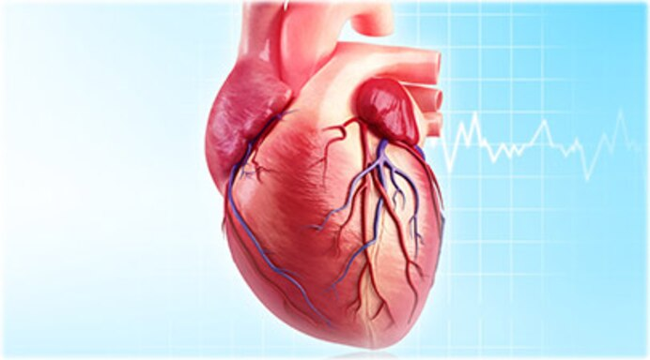

Heart failure predicter using dt
Machine learning can predict survival of patients with heart failure from serum creatinine and ejection fraction or all feature…

Slide 2
Project overview
Names of project builder
Introduction
Dataset & its Explanation
Abstract
Method
Result
Conclusion
Software required
Reference

Slide 3
Names of project builder
SANKET YEWALE
SHRIKANT SHEJWAL
SAURABH KADAM
KUNAL JIRAGE

Slide 4
introduction
In this heart prediction project we are going to see weather the patient heart fail or not using one of the most famous algorithm called as Decision Tree Classifier in Machine Learning. In this project dataset is downloaded from UCI repository and this dataset is real. this dataset is collected one of the most famous hospital is in United Kingdom(UK) in 2015 & this dataset are uploaded in UCI repository in June 2020. in this dataset there are 299 records and 12 features(attribute) and one label.
Age, anaemia, creatinine_phosphokinase, diabetes, ejection_fraction, high_blood_pressure, platelets, serum_creatinine , serum_sodium, sex, smoking, time this all features in our dataset and label is DEATH_EVENT. Labels are represented by 0 & 1. where 1 is represented by patient is survived and 0 represent patient is not-survived.

Slide 5
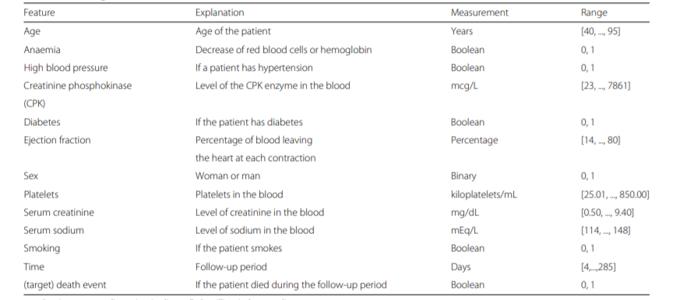
Dataset & its Explanation

Slide 6
Abstract
Cardiovascular diseases kill approximately 17 million people globally every year, and they mainly exhibit as myocardial infarctions and heart failures. Heart failure (HF) occurs when the heart cannot pump enough blood to meet the needs of the body.
Available electronic medical records of patients quantify symptoms, body features, and clinical laboratory test values, which can be used to perform biostatistics analysis aimed at highlighting patterns and correlations otherwise undetectable by medical doctors. Machine learning, in particular, can predict patients’ survival from their data and can individuate the most important features among those included in their medical records.

Slide 7
Method
In this project, we analyze a dataset of 299 patients with heart failure collected in 2015. We apply several machine learning classifiers to both predict the patients survival, and rank the features corresponding to the most important risk factors. We also perform an alternative feature ranking analysis by employing traditional biostatistics tests, and compare these results with those provided by the machine learning algorithms. Since both feature ranking approaches clearly identify serum creatinine and ejection fraction as the two most relevant features, we then build the machine learning survival prediction models on these two factors alone.

Slide 8
method
This project is based on machine learning classification. There are two types of classification one is Binary class classification and other is Multiclass classification so our project is based on Binary Class Classification. Weather patient is survived or not (1 & 0).
There are many algorithms to solve classification problem like Decision Tree, KNN, random forest classifier but here we use decision tree. So decision tree it means simple graph without circuit and the main part of the decision tree is the Root node, internal node and leaf node(labels).
First one to install scikit learn (sklearn) packages and collect the dataset weather is in UCI repository, kaggel or github this three platform we are able to download or collect the datsets.
In jupyter notebook import the datasets and check the information about datasets weather the any missing values is there or not. Then describe the datasets.

Slide 9
method
Next we correlate our datasets by using Pearson correlation coefficient
Calculate mean and standard deviation.
Drawing the histography for all attributes or features.
See our target and drop that target column because if we are not drop the target table the machine can view our target the machine overfitted that target in that case accuracy is high but when coming new record the machine are not able to classify correctly that’s why we drop target table in our dataset target is last column i.e., DEATH_EVENT this is our target.
calculate the count for each target class
Analysing all attributes with the help of graphs.

Slide 10
method
Slicing the data or splitting the data. Here to split data for training and testing so in our dataset there are 299 records of patients. We use 250 out of 299 for training and other(49) records for testing. Same like that also split the target.
Train the model by using Decision Tree Classifier from machine learning.
Then calculate the mean squared error it means difference of actual minus predicted by using mean_squared_error().
Test the model.
Also calculate the Confusion Matrix, Precision, Recall, f1-score or f-Measure and accuracy of the model.

Slide 11
Result
Our results of these two-feature models show not only that serum creatinine and ejection fraction are sufficient to predict survival of heart failure patients from medical records, but also that using these two features alone can lead to more accurate predictions than using the original dataset features in its entirety. We also carry out an analysis including the follow-up month of each patient: even in this case, serum creatinine and ejection fraction are the most predictive clinical features of the dataset, and are sufficient to predict patients’ survival.

Slide 12
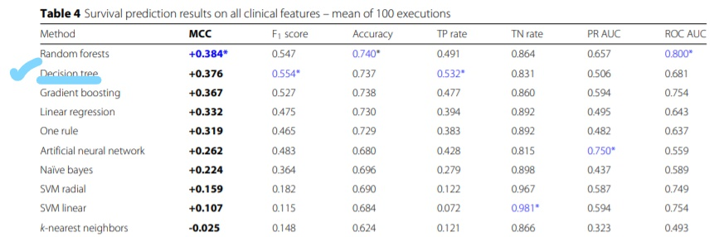
Result

Slide 13
Result
The Decision Trees obtained the top results on the true positives (sensitivity = 0.532) and on the F1 score (0.554), and was the only classifier able to predict correctly the majority of deceased patients.

Slide 14
Conclusion
This discovery has the potential to impact on clinical practice, becoming a new supporting tool for physicians when predicting if a heart failure patient will survive or not. Indeed, medical doctors aiming at understanding if a patient will survive after heart failure may focus mainly on serum creatinine and ejection fraction.

Slide 15
Software required
Windows 10
Python 3.0
Jupyter Notebook
Sklearn packages
Pandas
Anaconda

Slide 16
Reference
UCI Dataset Repository
World Health Organization, World Heart Day. https://www.who.int/ cardiovascular_diseases/world-heart-day/en/. Accessed 7 May 2019.
12th std Biology book.
Google

Slide 17
Future plan
Heart Failure Classifier
Age
Anaemia
High blood pressure
CPK
Diabetes
Ejection fraction
Sex
Platelets
Serum creatinine
Serum sodium
Smoking
Time
RESET
SUBMIT

Slide 18
THANK YOU

